Slide 1
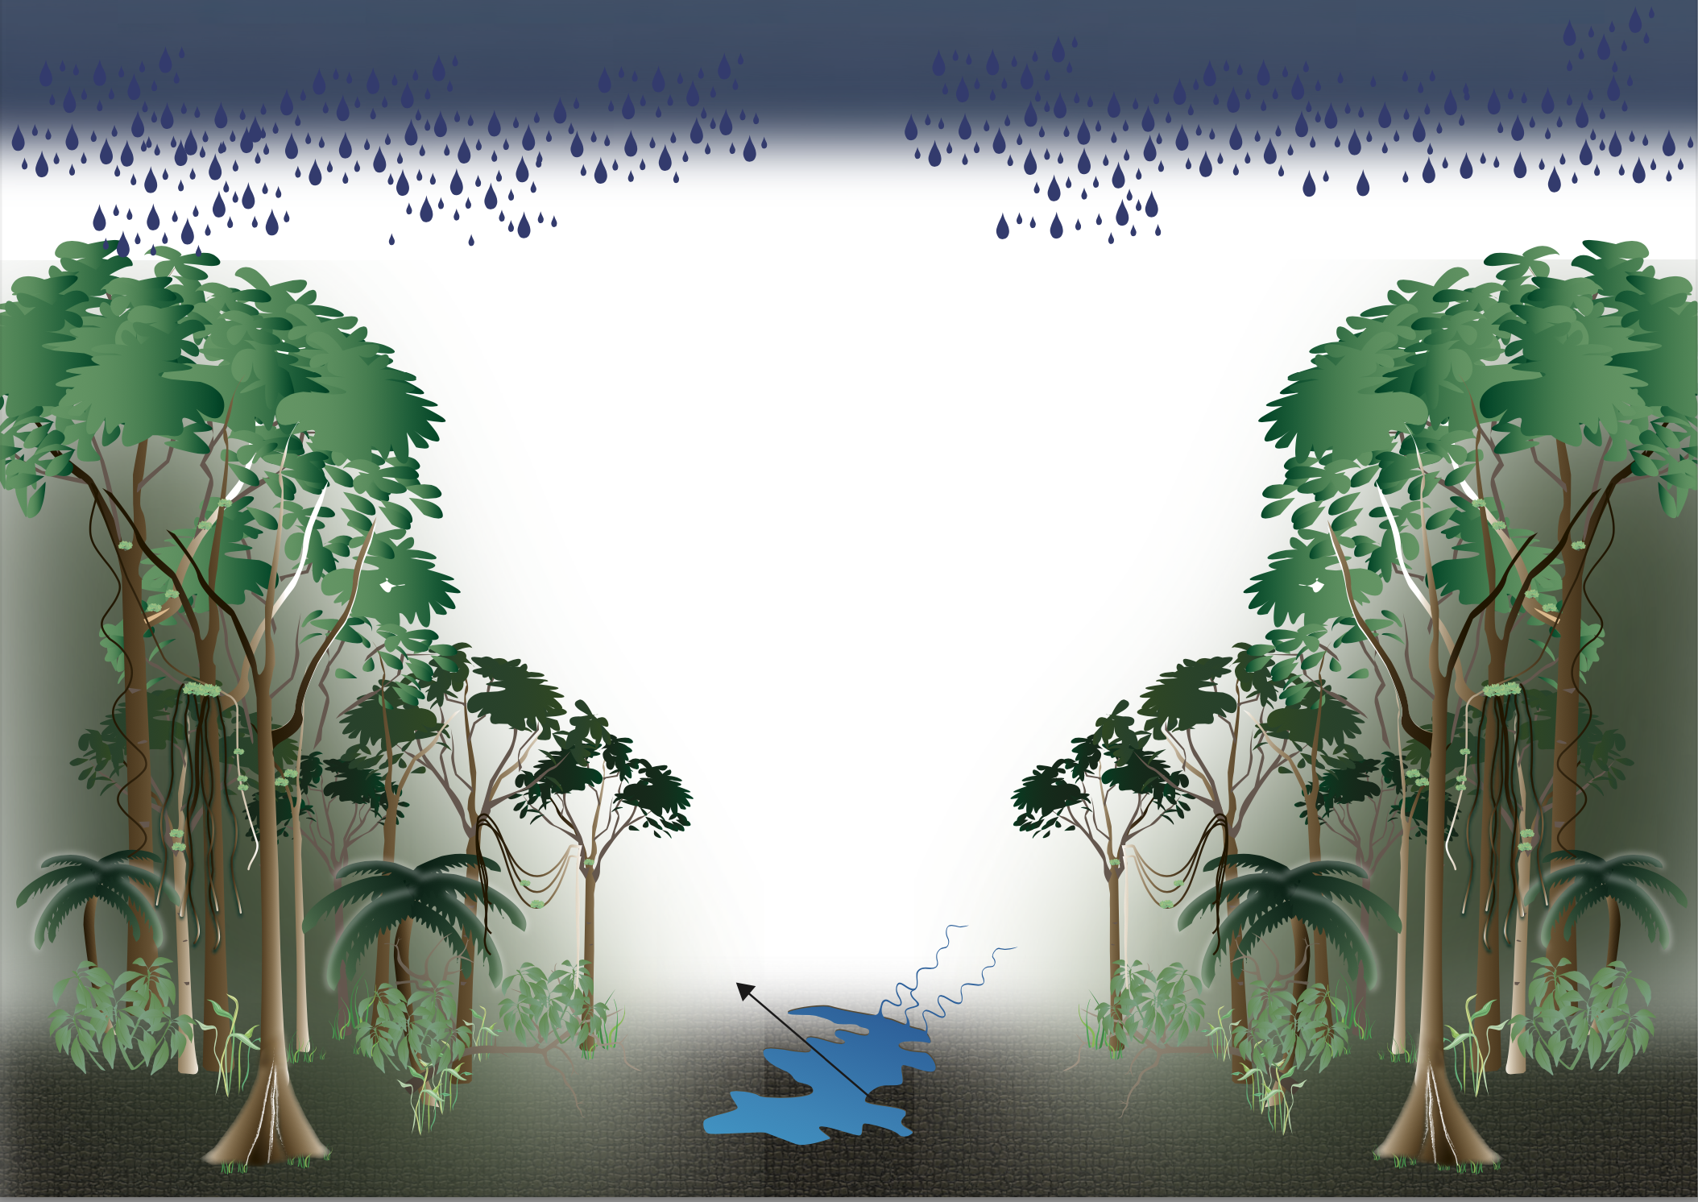
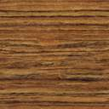
(a)
(b)
≥60 cm DBH trees
ANPP_{woody}
#- # %
M_{woody}
#- # %
10-60 cm DBH trees
ANPP_{woody}
#- # %
M_{woody}
#- # %
<10 cm DBH trees
ANPP_{woody}
#- # %
M_{woody}
#- # %

